Slide 1

Roots of polynomial
Sami Odeh - 315654962
Ayman Odeh - 316546092

Slide 2
Introduction
Newton Raphson
Bisection
Combination of Newton Raphson and Bisection
How it works?
Code optimization
Pros and Cons of the programming languages
Runtime comparison
Implementation

Slide 3
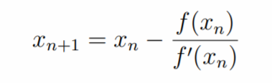
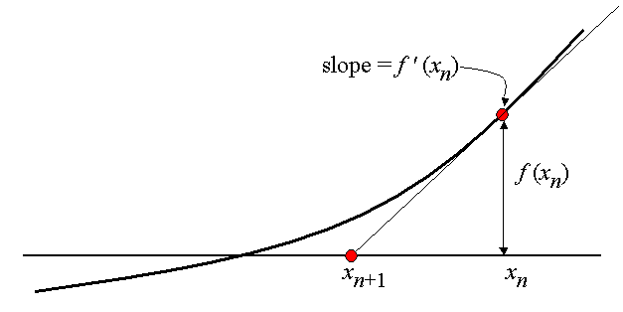
NEWTON Raphson Algorithm
The Newton Raphson method is for solving equations of the form f(x) = 0. We make an initial guess for the root we are trying to find, and we call this initial guess x0. The sequence x0, x1, x2, x3, . . . generated in the manner described below should converge to the exact root.

Slide 4
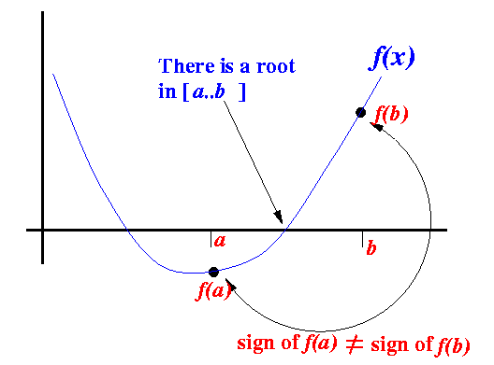
BISECTION Algorithm
The Bisection Method is a successive approximation method that narrows down an interval that contains a root of the function f(x)
The Bisection Method is given an initial interval [a..b] that contains a root
The Bisection Method will cut the interval into 2 halves and check which half interval contains a root of the function
The Bisection Method will keep cut the interval in halves until the resulting interval is extremely small

Slide 5
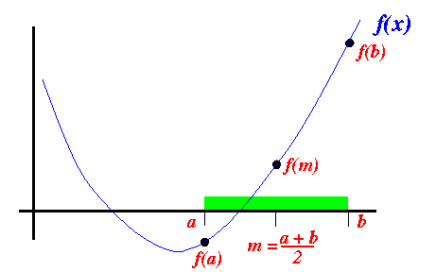
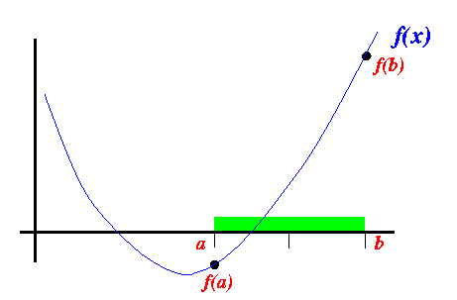
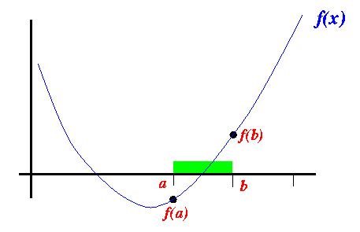
BISECTION Algorithm
We cut the interval [a..b] in the middle: m = (a+b)/2
suppose the interval [a..b] is as follows
Shrink interval according to sign of a , b and m.

Slide 6
Combination of Newton Raphson and Bisection
An algorithm for finding x such that f(x) = 0 is called a root-finding algorithm.
The Bisection method using the intermediate value theorem is the simplest root-finding algorithm. Note that the bisection method converges slowly but it is reliable.
The Newton-Raphson method using the derivative of a given nonlinear function is a root-finding algorithm which is more efficient than the bisection method but may not be reliable.
Problems with Newton-Raphson method that it can stuck in an infinite loop or bad start points.
So, in order to improve the algorithm of finding roots of polynomial we can use Both methods as combination.

Slide 7
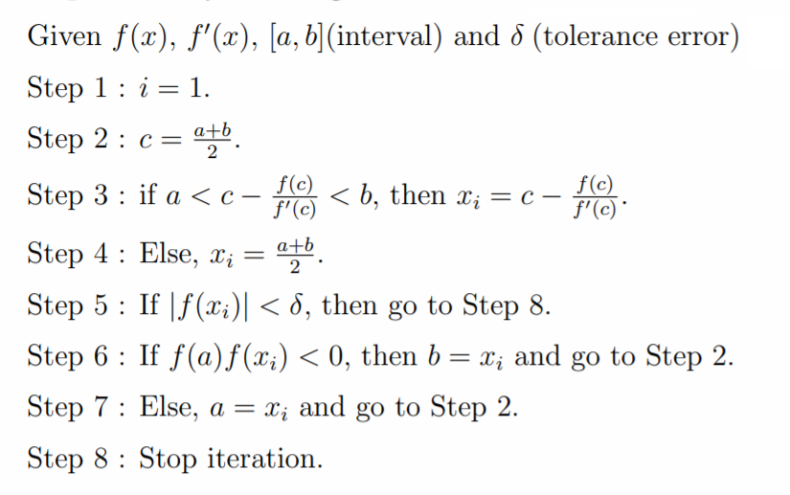
Combination of Newton Raphson and Bisection

Slide 8
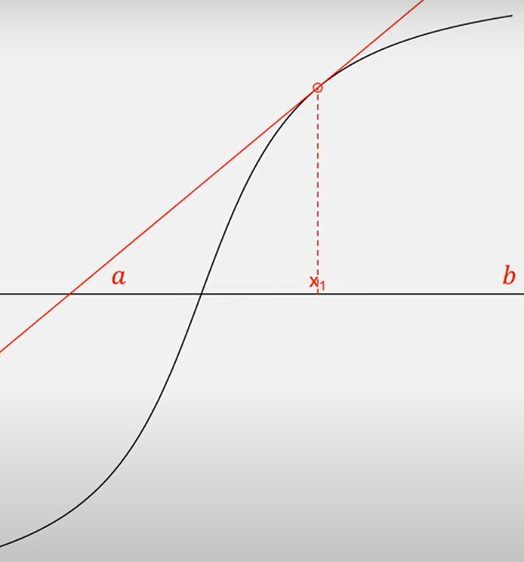
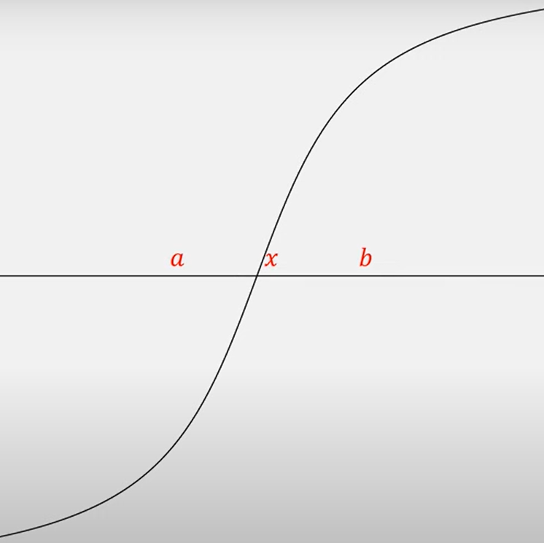

Slide 9
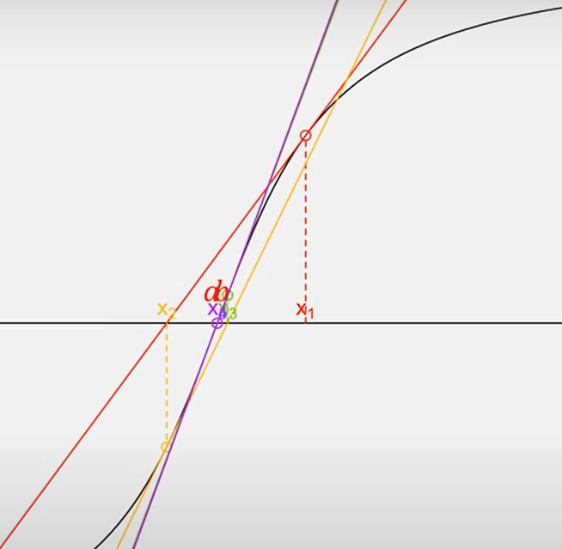
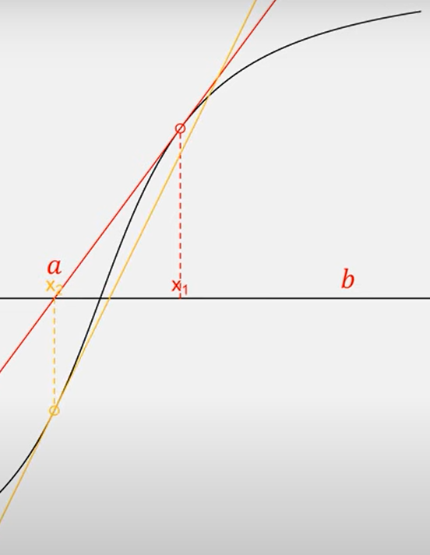
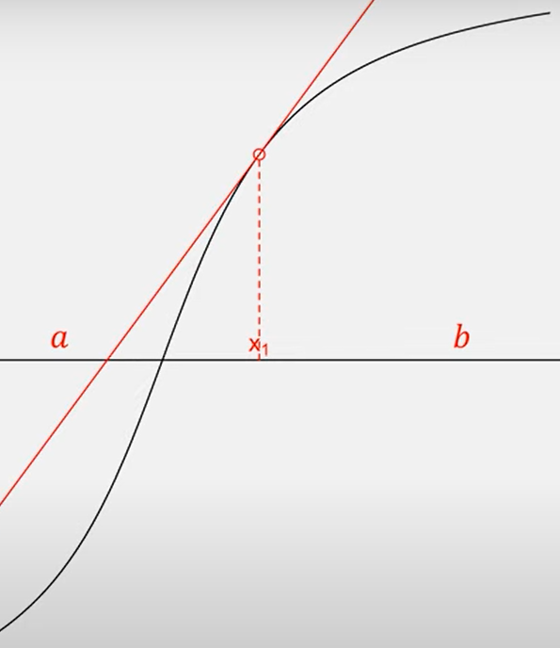

Slide 10
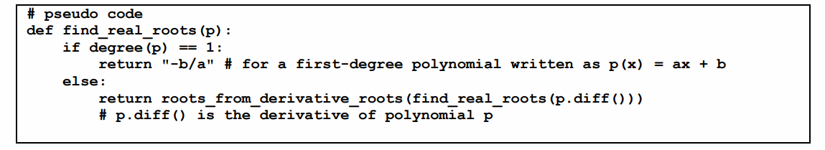
How it works
algorithm that finds all the real roots of a polynomial, using the roots of its derivative to obtain isolating intervals. Roots of the derivative are found by recursive applications of the method, until a first degree polynomial is found.
The function roots_from_derivative_roots uses the roots of the polynomial derivative to find isolating intervals, and then calls the algorithm that combines bisection and newton Raphson.

Slide 11
How it works
Root isolating from derivative is based on:
let 𝑣0 < 𝑣1 < ⋯ < 𝑣𝑑 where 𝑑 ≥ 0 denote all 𝑑 + 1 distinct real roots of 𝑝′. The algorithm considers the following intervals, For each of these intervals, with simple tests we can decide if the interval contains zero or one root of the polynomial. By our basic theorem, none of these intervals can contain more than one root.

Slide 12
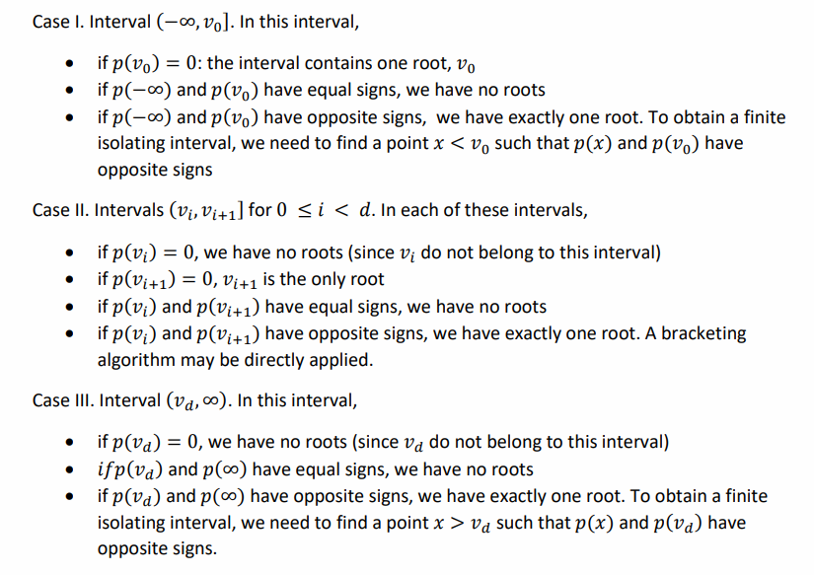

Slide 13
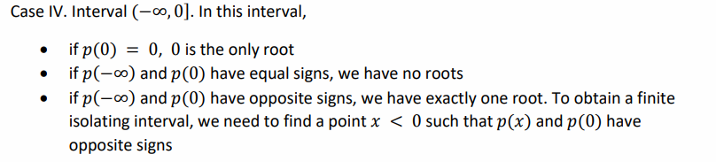
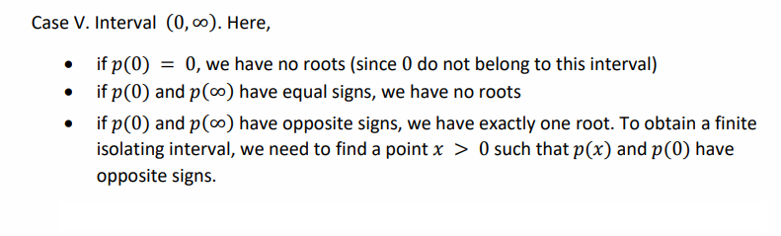
if derivative 𝑝′ has no roots:

Slide 14
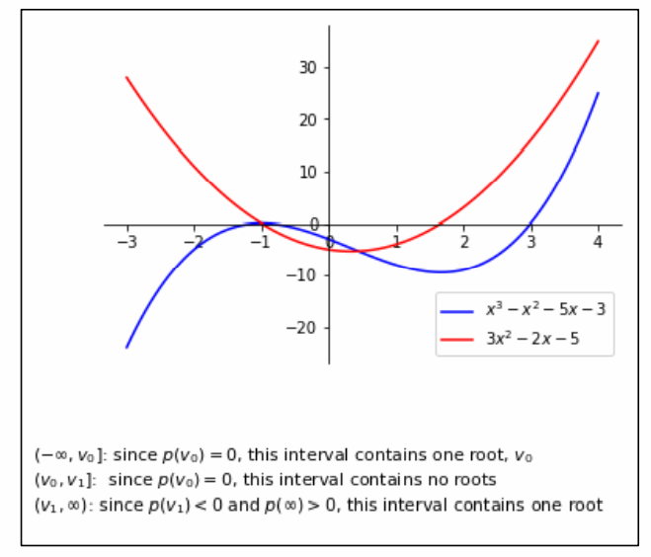
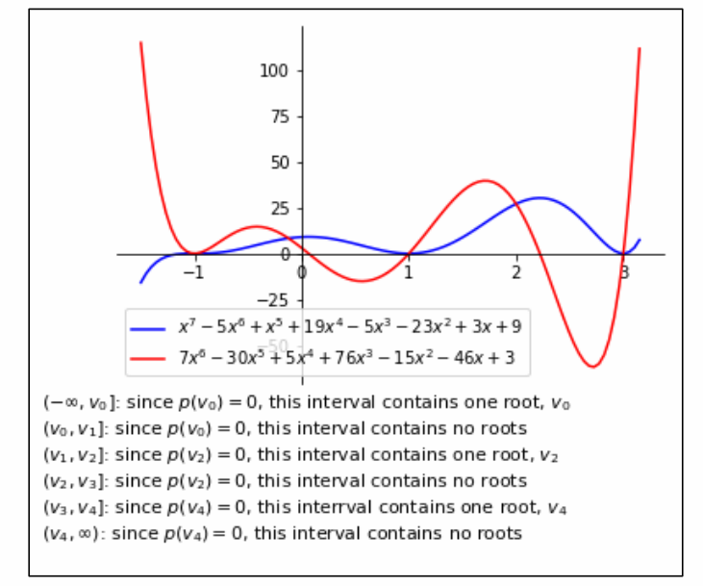

Slide 15
CODE OPTIMIZATION
C++
Dynamic allocations! (Vectors)
STL Algorithms
References
Python
NumPy library!

Slide 16

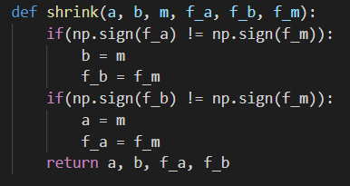
CODE OPTIMIZATION
optimized polynomial evaluate:
Allocated specified memory in C++ with vectors reserve function, instead of copying and allocate new memory every time we add to vector.
optimized multiply operations : instead of checking f(a)*f(b) <= 0 we check if sign(f(a) != sign(f(b))
Update interval [a,b] with new x, no need to calculate f(a) or f(b) again, we can use the f(x) to get it.

Slide 17
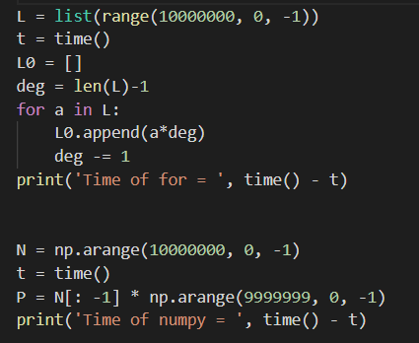

CODE OPTIMIZATION
Calculating the derivative of polynomial based on the pervious one, and we can see the difference in time between using for loop and NumPy operations.

Slide 18
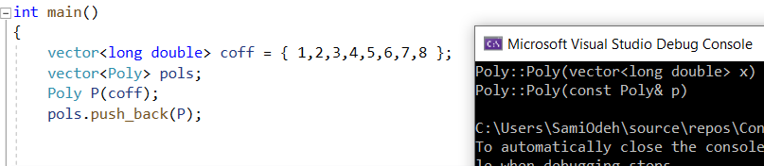
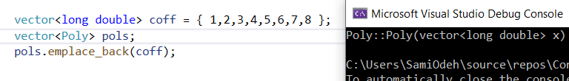
CODE OPTIMIZATION
Reducing the number of copy constructors using vector method emplace_back instead of push_back.

Slide 19

pros and cons
C++
PROS
Dynamic allocation
OOP
References
CONS
No garbage collector
Less readable code
Python
PROS
Many efficient libraries (built in code optimization)
Much less code
CONS
No dynamic allocations

Slide 20
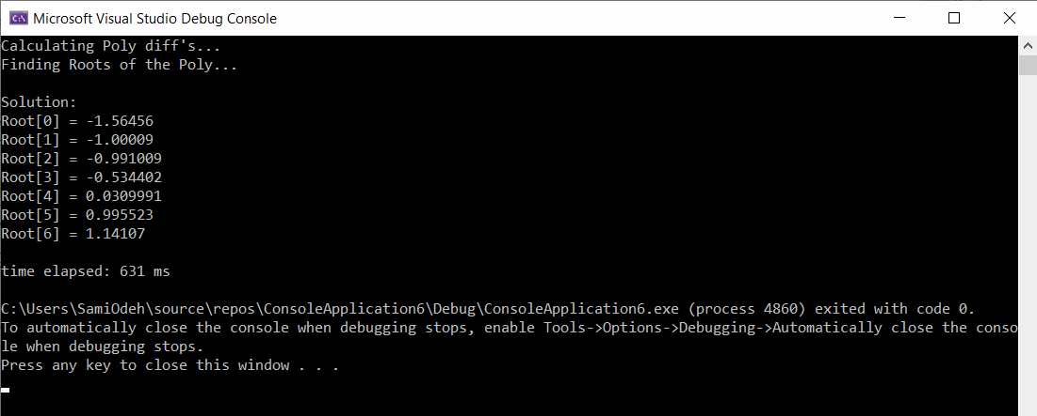
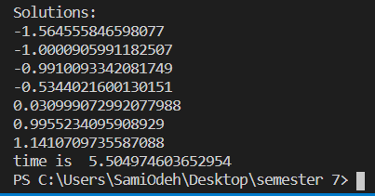
Runtime – CPP – all optimizations
Python

Slide 21
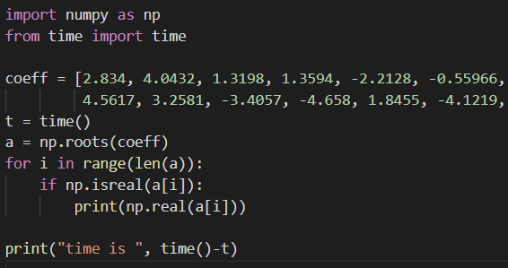
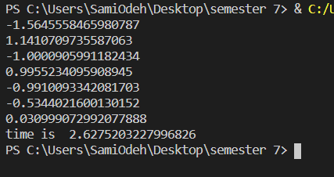
Runtime – PYTHON NumPy

Slide 22
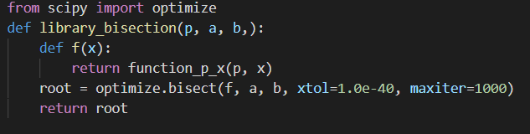
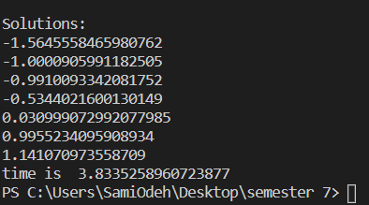
Runtime – Scipy.optimize.bisec

Slide 23
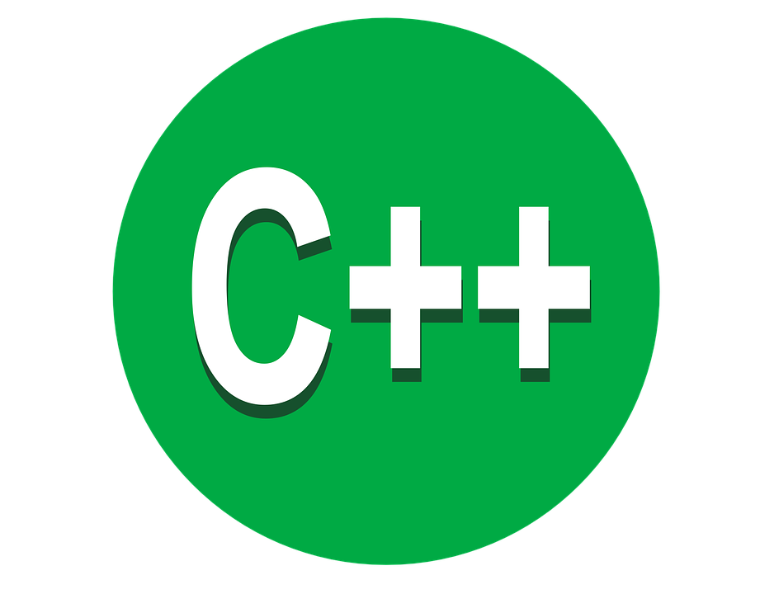

Implementation

